Slide 1
Viral, fungal and parasitic infections of the skin
Dr. Indira Kahawita
Consultant Dermatologist
Base Hospital Homagama

Slide 2
Viral infections
Viral warts
Herpes simplex
Varicella
Herpes zoster
Molluscum contagiosum
Exanthems
Hand foot and mouth disease

Slide 3
Viral warts
Commonest viral infection among clinic attendees
Common in children and young adults
Transmitted by touch
May spread to sites of trauma
Some resolve spontaneously but some persist for a long time

Slide 4
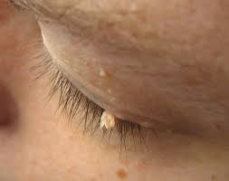
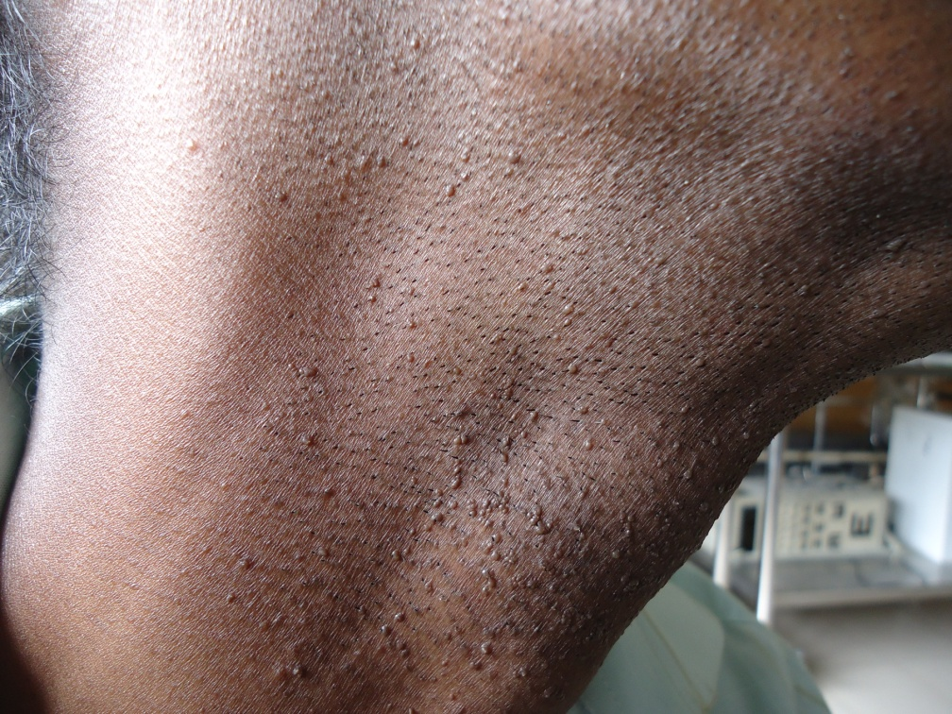
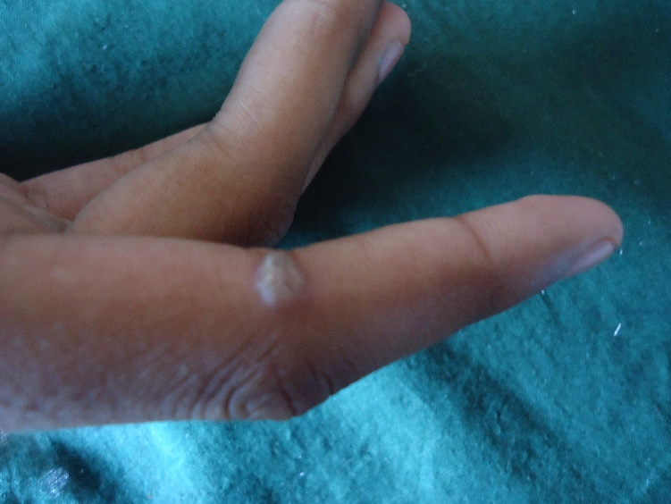
Types of warts
Common warts
Plane warts

Slide 5
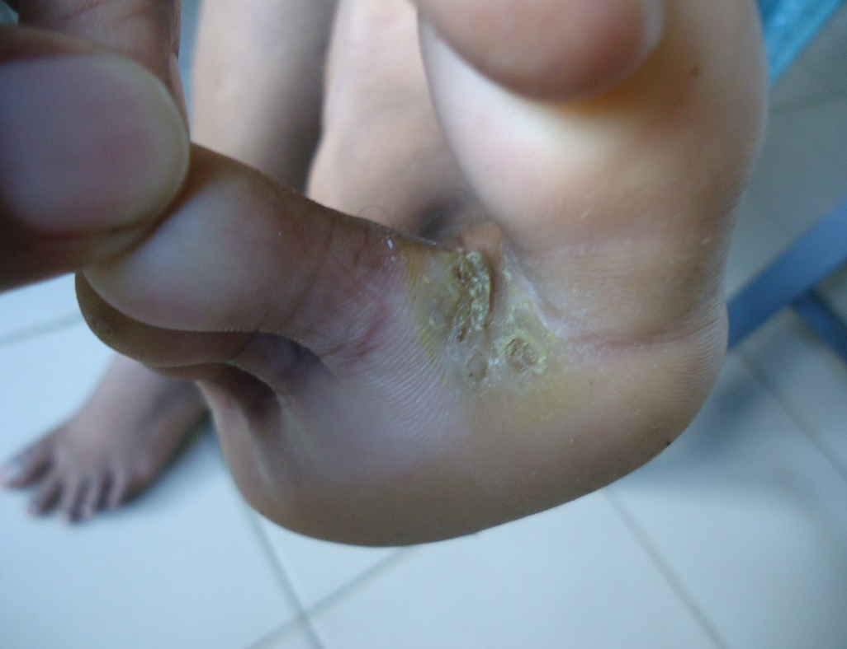
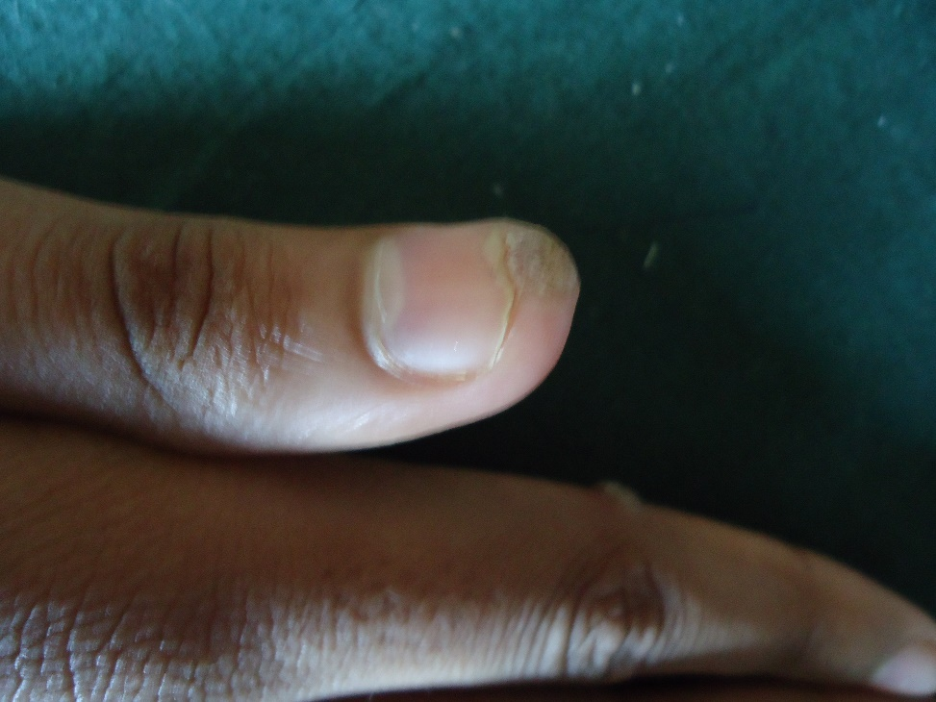
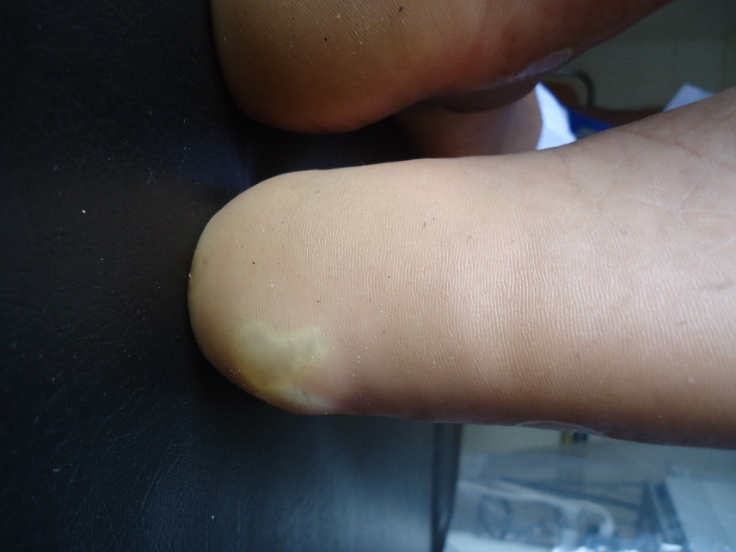
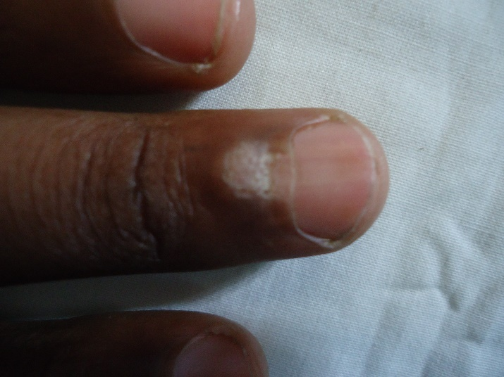
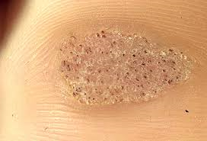
Types of warts
Plantar warts
Peri-ungual warts

Slide 6
Treatment of warts
The treatment of choice is cryotherapy
Salicylic acid solutions may me used at home
Blunt dissection
Corn plasters
Imiquimod (may be useful in non genital warts if used under occlusion)

Slide 7
Molluscum contagiosum
Commoner in children
Discrete dome shaped skin coloured papules with central umbilication
Spares palms and soles
Spread via autoinoculation, scratching, touching or by fomites

Slide 8
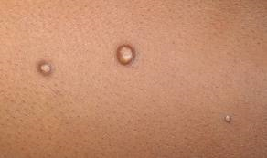
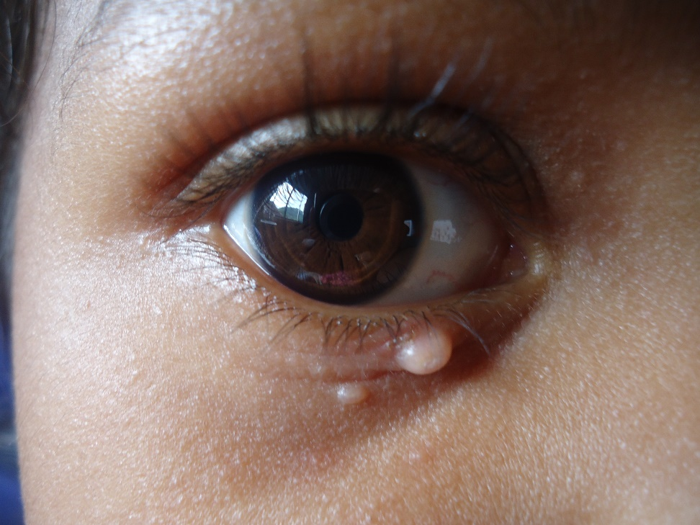

Slide 9
Treatment
Mothers can be taught to apply 5-10% KOH at home
With a tooth pick/ ekel
Until the lesions become black in colour
TCA application
Curettage
Cryotherapy

Slide 10
Herpes simplex infections
Due to HSV 1 or HSV 2
Primary infection may be asymptomatic
Usually spread via direct contact
Clinical progression
Grouped vesicles on an erythematous base
Usually all vesicles are of similar size
Vesicles rupture to leave crust/ exudate
Recurrence is the rule

Slide 11
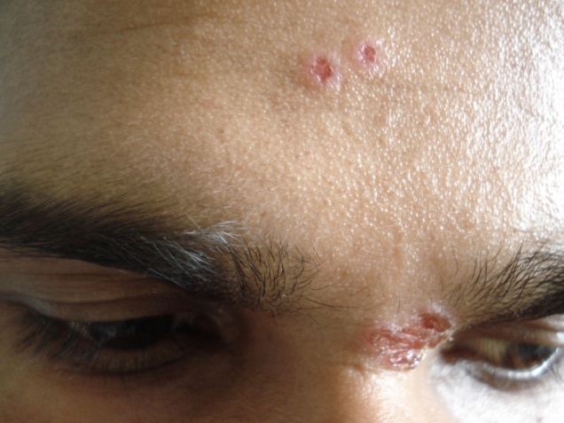
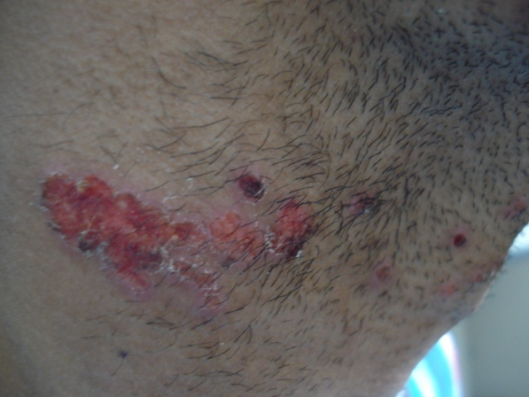

Slide 12
Treatment
Oral aciclovir
Doses differ with type of infection
Best to check BNF before prescribing
Frequent recurrences may be treated with suppressive therapy

Slide 13
Herpes zoster
Pre eruptive pain, itching, burning localized to a dermatome may precede eruption by several days
Eruption begins with red swollen plaques
Clustered vesicles are of varying sizes and stages of progression
Vesicles umbilicate and crust
Post herpetic neuralgia may be a troublesome problem

Slide 14
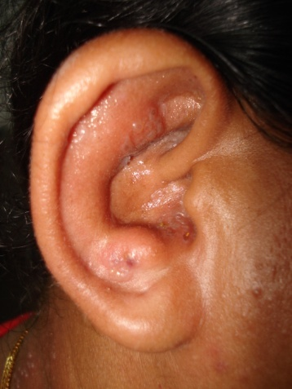
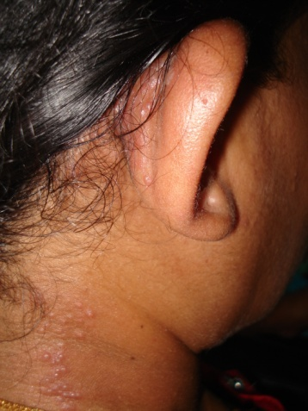

Slide 15
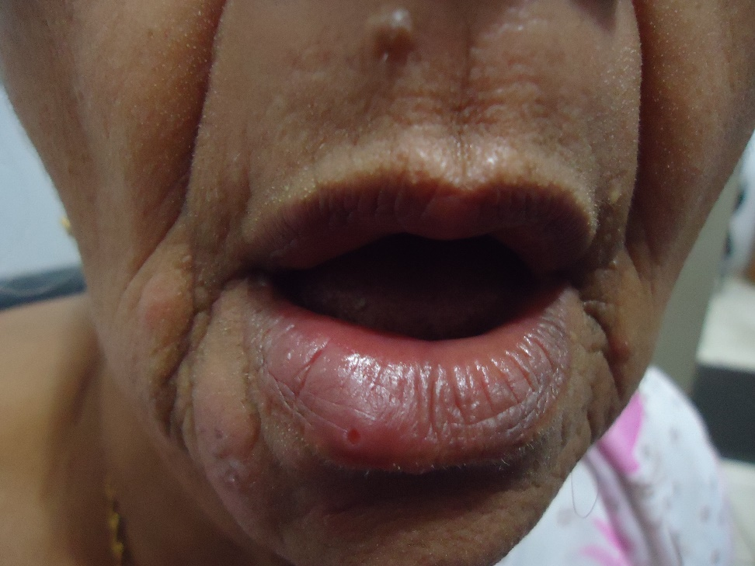
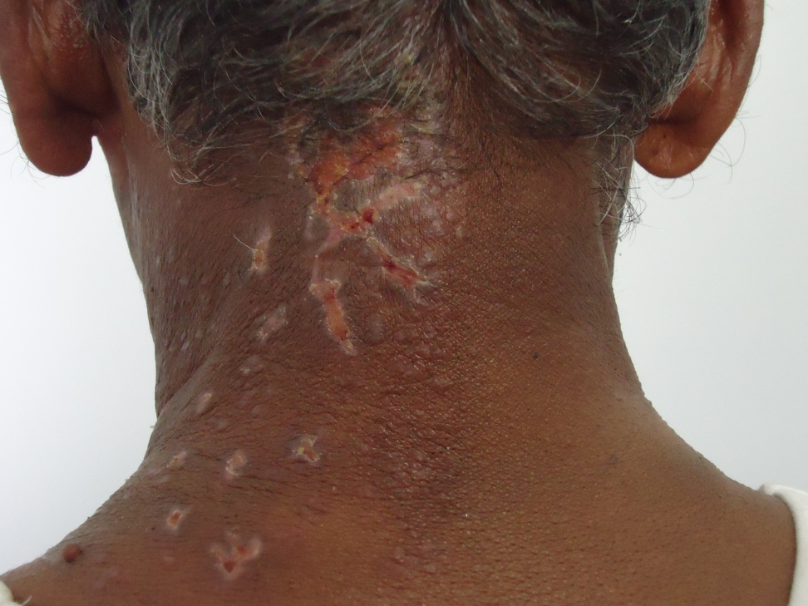

Slide 16
Treatment
Aciclovir 800mg 5 times daily for 7 days
Refer BNF for paediatric doses
Amitriptylline, gabapentine or pregabalin can be used for neuralgic pain

Slide 17
Fungal infections
Dermatophytoses
Tinea of the skin
Tinea capitis
Kerion
Onychomycosis
Candidiasis
Pityriasis versicolor

Slide 18
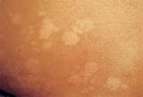
Pityriasis versicolor
Due to Malassezia furfur (a yeast)
M. furfur is part of the normal flora
Can be hypo/ hyperpigmented
Mostly in the trunk
Can occur in the eyelids in neonates
Most persons are affected, difficult to eradicate
Recurrences are common

Slide 19
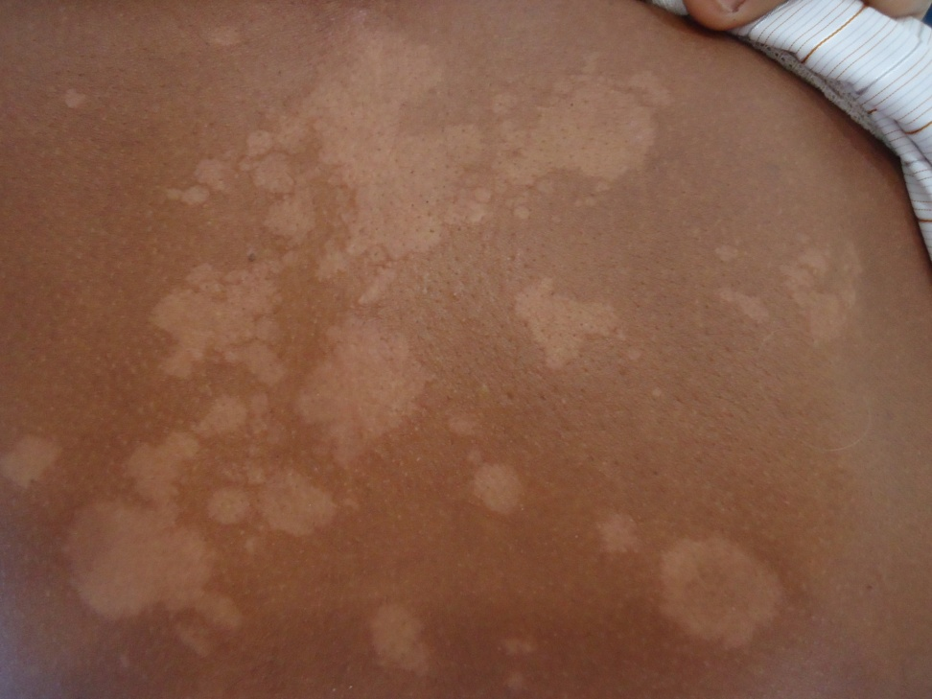
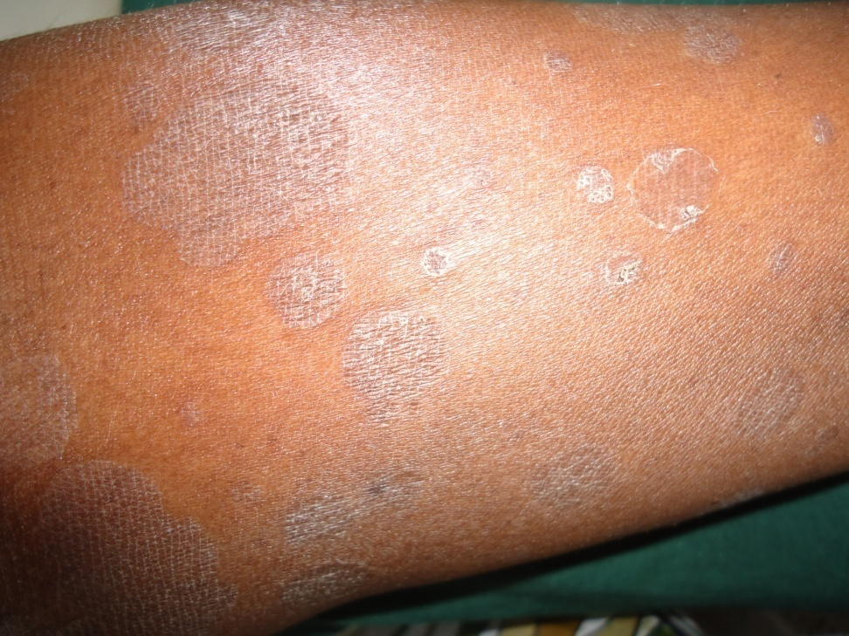

Slide 20
P. Versicolor: treatment
A cure is difficult to achieve
Topical therapy:
Any azole preparation
Shampoos/ lotions for extensive disease
Creams for isolated lesions
Whitfield's ointment can be effective
Selenium sulphide/ zinc pyrethione lotions can be used
Oral therapy
Itraconazole 200mg daily for 1 week
Ketoconazole, the popular choice, should be used with great caution
Griseofulvin has no place (not active against yeasts)

Slide 21
Dematophytoses
Caused by filamentous fungi
The causative fungi may be anthropophilic, zoophilic or geophilic
Can affect skin, hair and nails
Different names according to location
Scalp: tinea capitis
Face: tinea faciei
Trunk: tinea corporis
Flexures: tinea cruris
Feet: tinea pedis

Slide 22
Tinea corporis and faciei
Common presentations
Facial lesions may not have the typical active edge/ ringworm appearance
Common to have lesions around ears
The appearance may be altered by the use of steroids

Slide 23
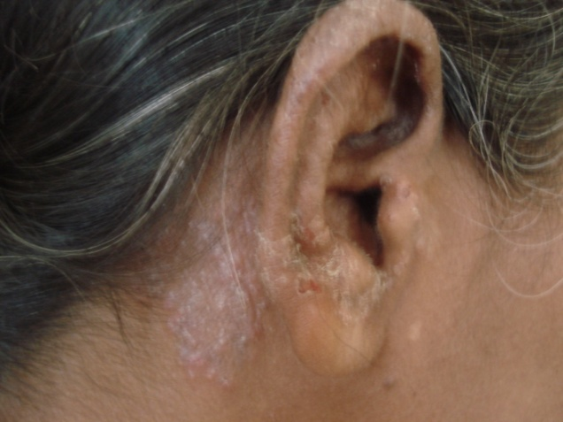
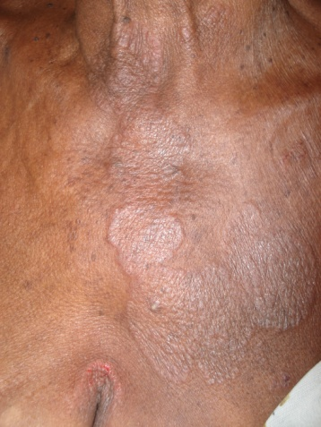
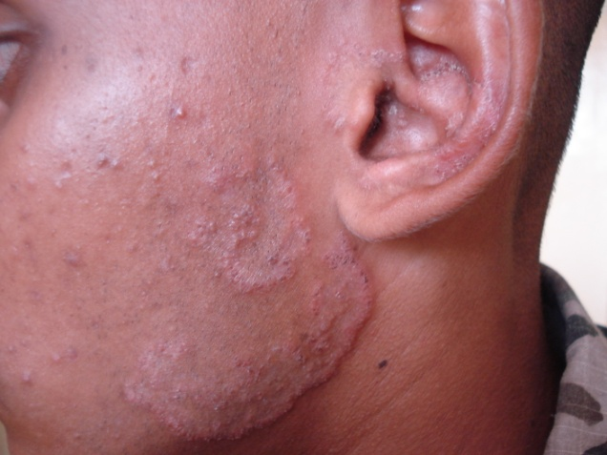
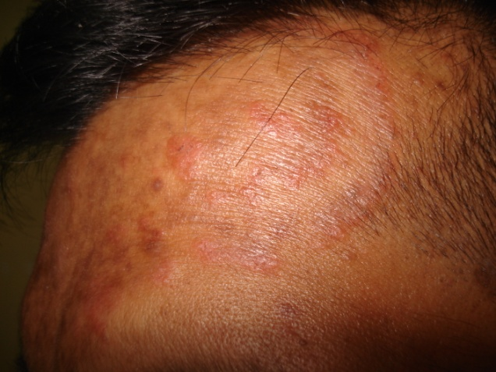

Slide 24
Treatment
Topical agents: should be applied for a minimum of 4 weeks. Poor response to Miconazole noted recently. ?resistance
Azoles
Whitfield’s ointment
Terbinafine
Oral agents
Griseofulvin
Azoles
Itraconazole
Fluconazole
Terbinafine

Slide 25
Few important points on oral anti fungal agents
All can be hepatotoxic
All can have drug interactions (sp. Warfarin)
None should be used in pregnancy/ lactation
Men should avoid fathering a child during and for 6 months after stopping griseofulvin therapy
Refer the BNF/ product literature if you are starting someone on oral anti fungal therapy

Slide 26
Tinea incognito
Altered clinical picture due to use of topical/ systemic corticosteroids
May present as itchy nodular lesions
Sometimes scaling in bizarre patterns (esp. in pt on systemic steroids)
High degree of suspicion needed.
A skin scraping may be very useful in confirming the diagnosis

Slide 27
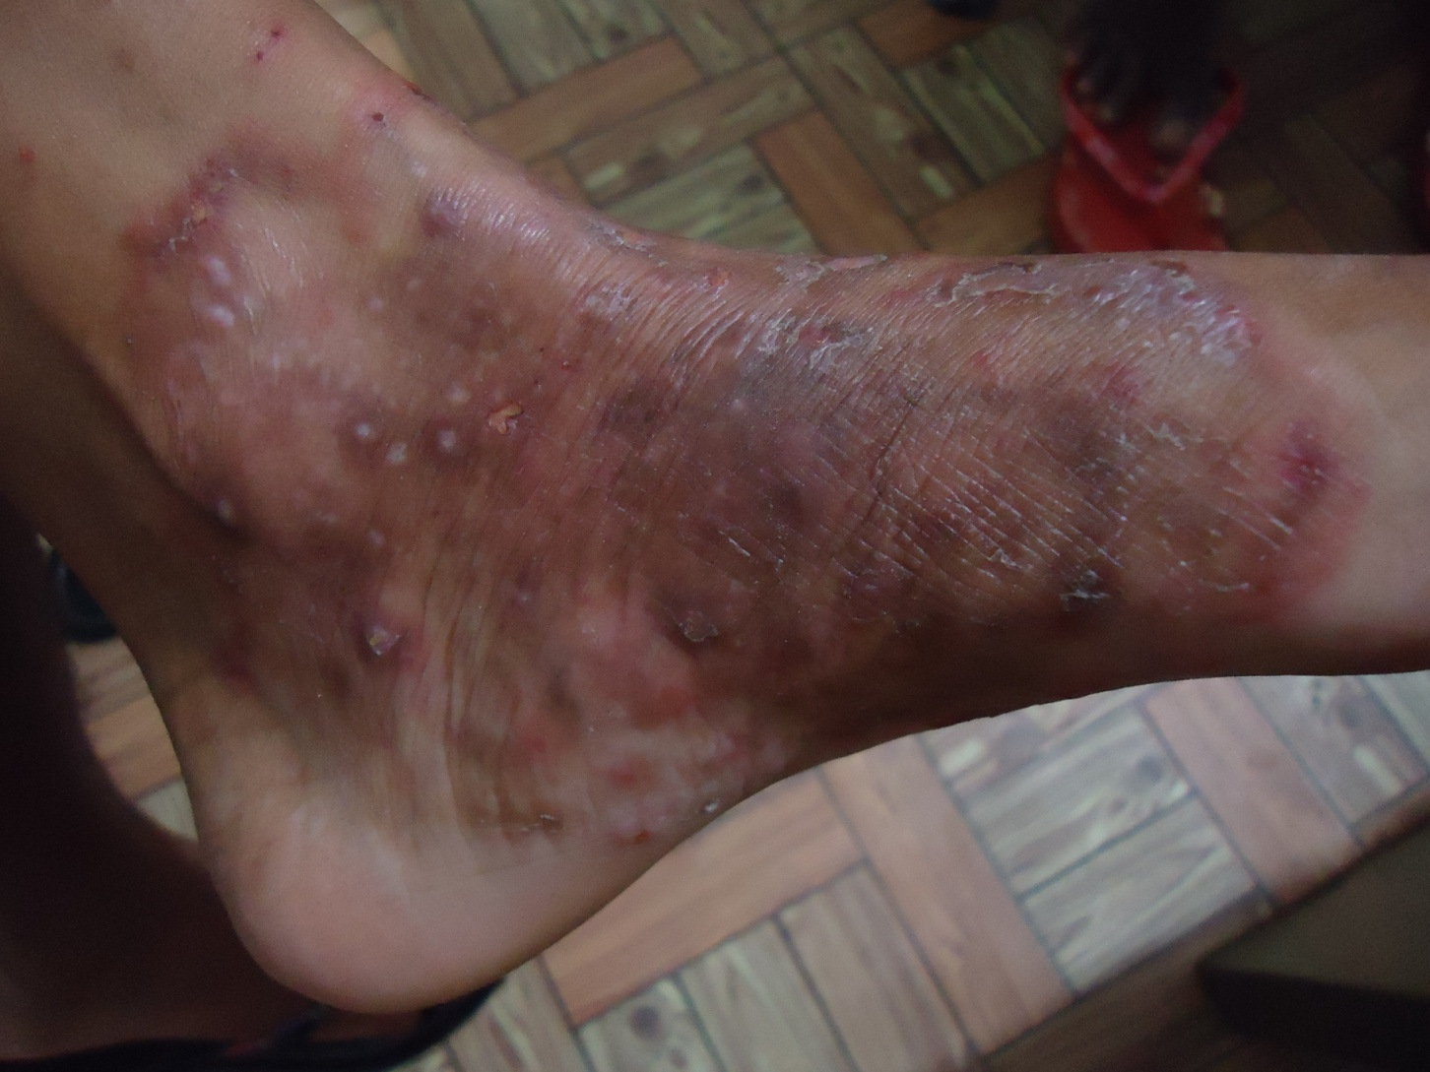
Tinea incognito

Slide 28
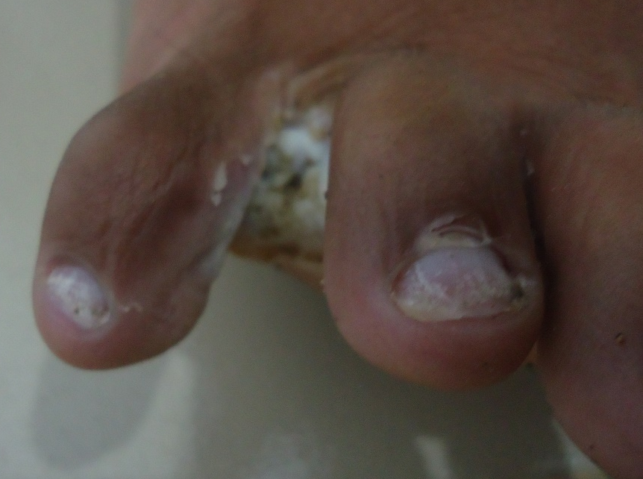
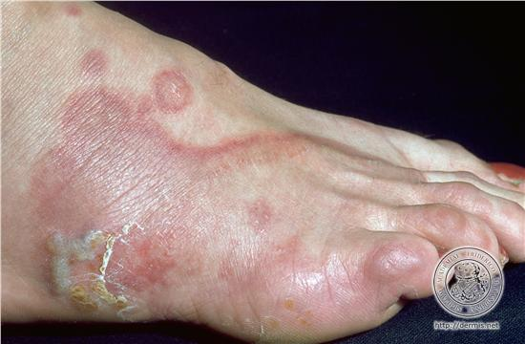
Tinea pedis
Common
Mostly involve toe webs
Maceration of the toe web skin
Look for underlying diabetes mellitus
Treatment
Topical azoles/ tolnaftate
Lotions/gels preferred over creams
Clotrimazole powder when wearing shoes
Oral fluconazole/ itraconazole
Avoid moisture

Slide 29
Superficial Candida infections
Can involve many sites
Mouth: oral thrush
Skin folds: intertrigo
Nails: onychomycosis and paronychia
Genitalia: balanitis/ vulvovaginitis
Feet: athlete’s foot

Slide 30
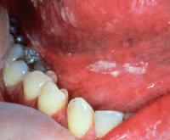
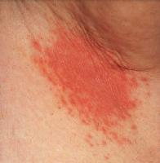
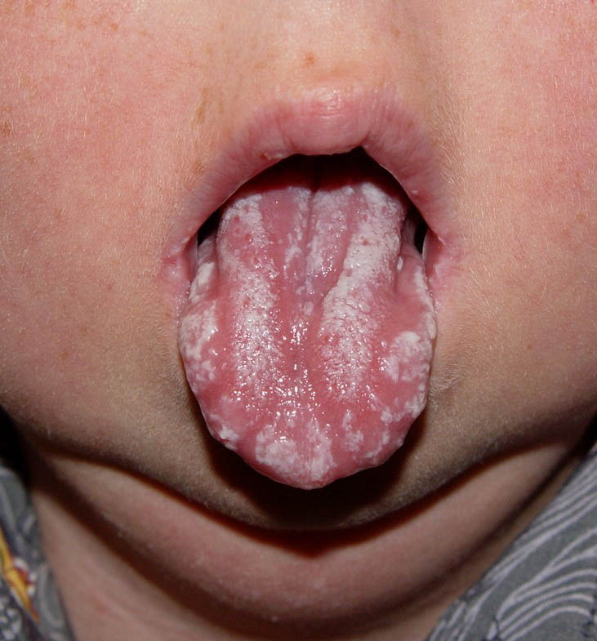
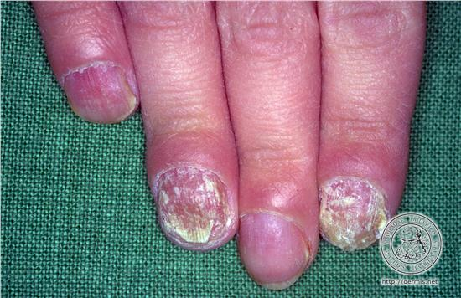
Many faces of candidiasis

Slide 31
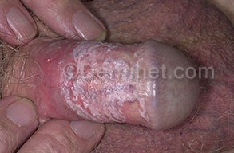
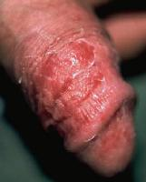
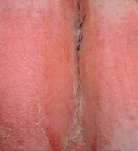
Genital infections
Vulvovaginitis and balanoprosthitis
May be a presenting feature of DM in men
Due to altered immunity in women
Need to treat both partners
Treatment
Topical azoles (pessary, vaginal tablets, gels, powders)
Single dose fluconazole
Single dose itraconazole

Slide 32
Parasitic infections/ Infestations
Scabies
Cutaneous larva migrans
Leishmaniasis

Slide 33
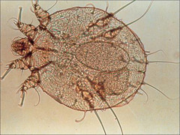
Scabies
Highly contagious disease
Caused by Sarcoptes scabei var. hominis
Spreads in households and environments with high frequency of intimate personal contact
Mites lay 2-3 eggs per day and need app. 2 weeks to reach maturity
Few symptoms during first month of contact with an infected individual
Mites can survive in environment for several days

Slide 34
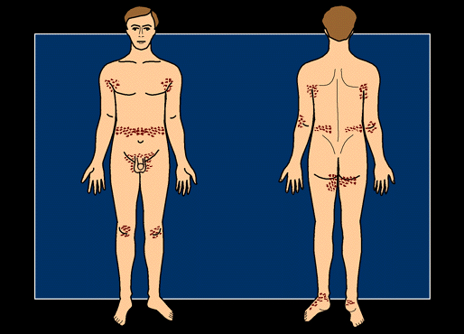
Clinical features
Nocturnal itch
Primary lesions:
Burrows
Vesicles
papules
Secondary lesions:
Excoriations
Pustules
Nodules
Infants may have palmoplantar and head and neck involvement
Clustered within families

Slide 35
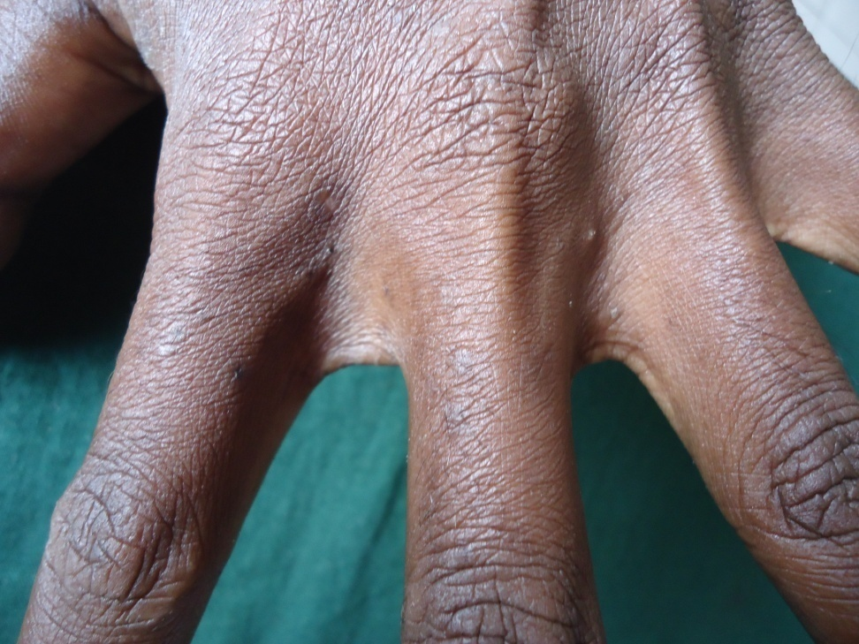
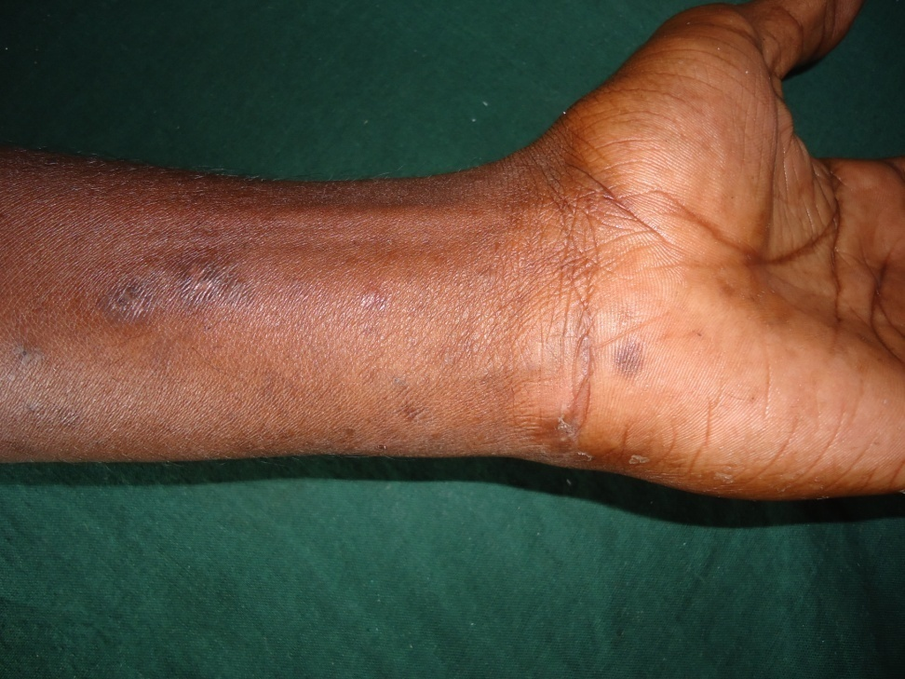

Slide 36
Treatment of scabies lindane is no longer licensed in Sri Lanka
All contacts should be treated
Cleaning of clothing that have come in direct contact with infected person is recommended
Persistent itching may need antihistamines for up to 2 weeks
Permethrin cream
All skin surfaces below neck (adult) include face in children
30g for single application for adult
Application on the hands including undersurface of nails is very important
Reapply to any areas washed
12 hours for adult
8-12 hours for infant
Repeat 7 days later

Slide 37
Treatment of scabies
Benzyl benzoate (BB cream)
Apply to whole body below neck after a bath (not hot bath)
Leave for 24 hours
Apply daily for 3-5 days
May be used in pregnancy
Sulphur ointment
Same as for BB cream
below 2y – 3%
2 -12 y – 5%
Adult - 10%
Can be used in infants, pregnant mothers

Slide 38
Cutaneous larva migrans
Due to wandering larvae of dog and cat hookworms
Mostly in extremities (feet are the commonest site)
Itchy raised track along the migratory route of the larva
Advancing edge shows inflammation while the older lesions may heal

Slide 39
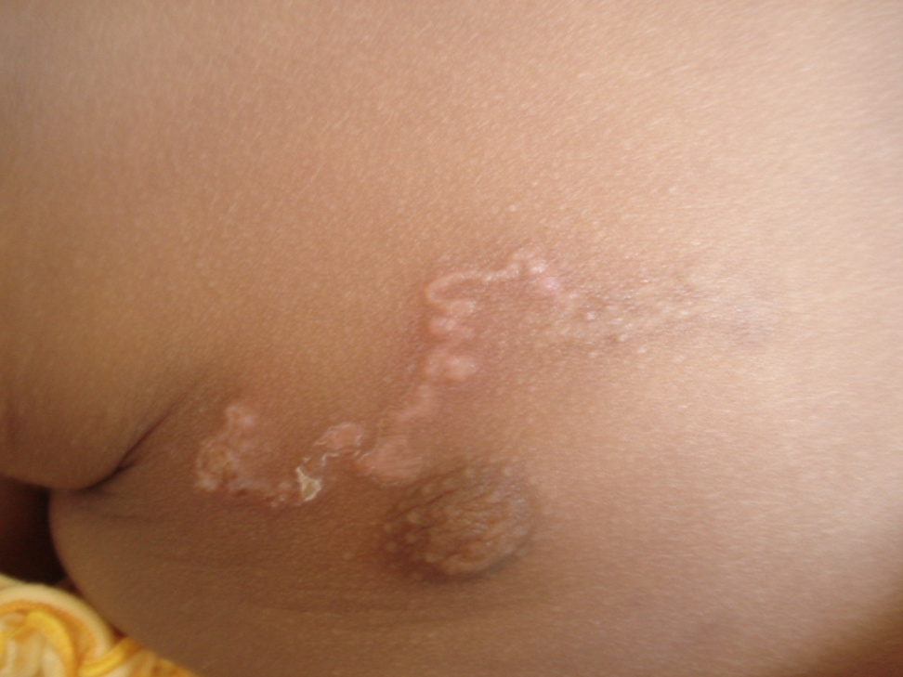
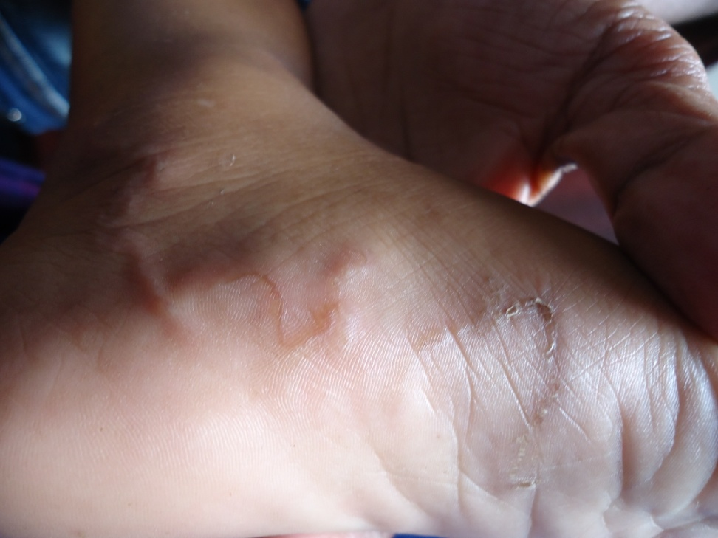

Slide 40
Treatment
Albendazole 400 -800 mg daily for 3 days
Oral ivermectin may also be effective
Management of secondary infection
Control of itch
Advise on avoidance of exposure

Slide 41
Cutaneous leishmaniasis
Due to protozoan (Leishmania donovani) transmitted by sandflies
Endemic in Southern and North Central provinces with cases reported from the Northern and Central provinces
Non healing nodule, plaque or ulcerated/ crusted nodule
Effective treatment available (intra-lesional antimony compounds and cryotherapy)
Refer to dermatology clinic

Slide 42
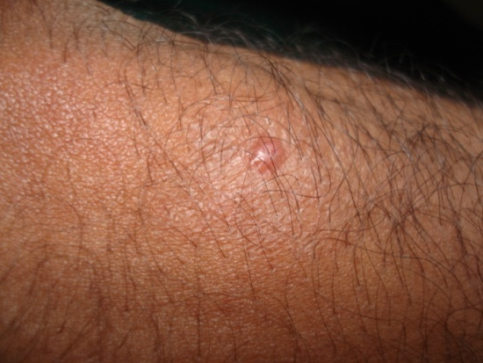
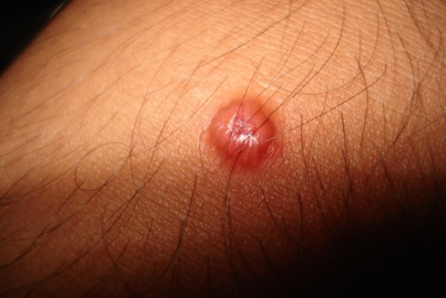
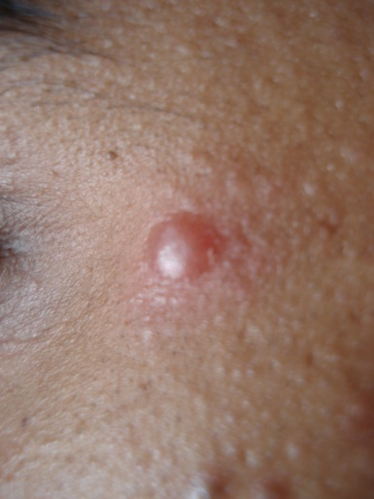
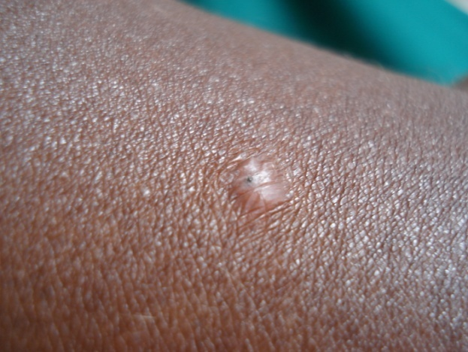
Persistent acneiform papule
Occur in exposed areas (face, upper limbs)
Slowly progressing
Asymptomatic

Slide 43
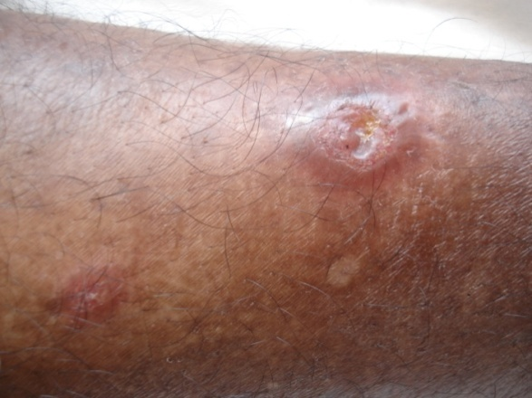
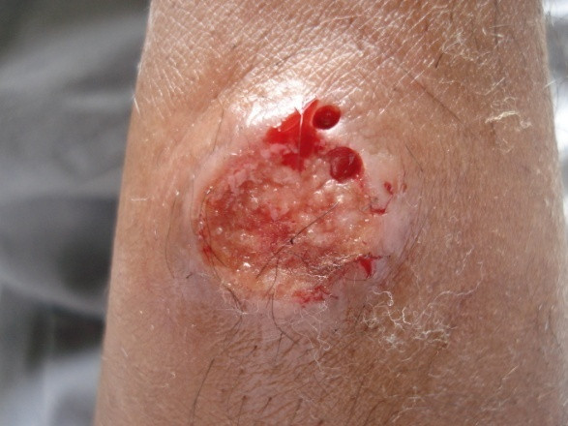
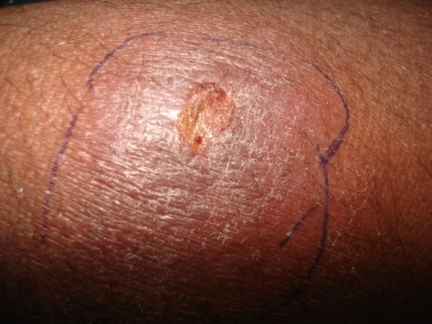
Ulcerated nodule
Central crust falls
Volcano shaped lesion
Usually painless unless secondary infection

Slide 44
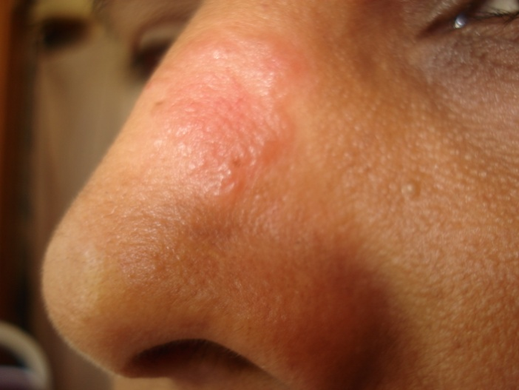
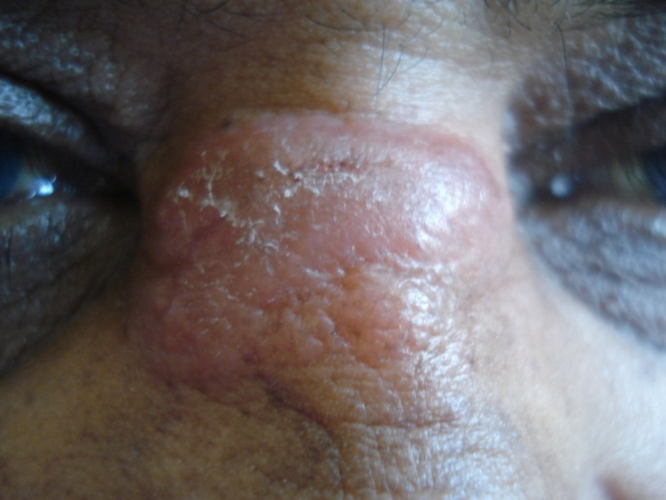
Plaque lesion
Erythematous/ skin coloured
Common in the face

Slide 45
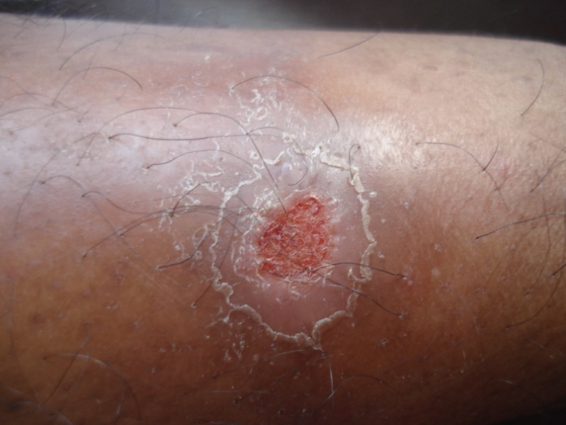
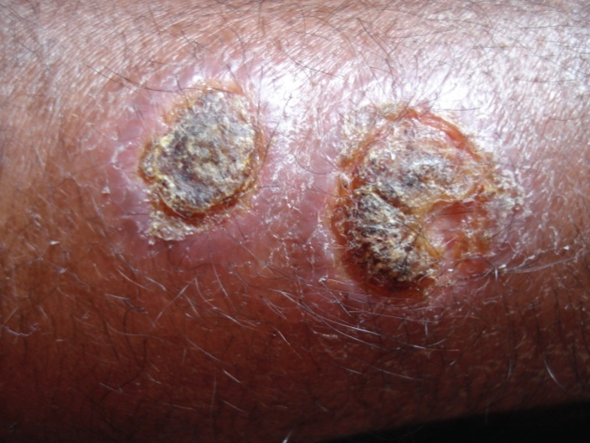
Non healing ulcer
Painless ulcers in exposed locations
Usually in legs/ forearms (cf. leprosy ulcers)

Slide 46






Lesions around orifices

Slide 47
How to suspect leishmaniasis
Typical lesions (asymptomatic/ long duration)
Epidemiology
Patients from southern, north central, north western, central provinces
H/O visits to such an area within last year
Rarely persons returning from the Middle East may have multiple lesions

Slide 48
Why should we treat CL?
Currently the best control measure is treatment of cases to reduce the reservoir
The number of cases is rapidly increasing
Self healing may occur but with scarring
Chronicity may be a problem
The organism causing CL in SL is known to be viscerotrophic
Some cases of visceral and mucocutaneous leishmaniasis have been reported

Slide 49
Treatment of cutaneous leishmaniasis
Sodium stibogluconate (intra lesional or intra muscular
Intra lesional metronidazole
Liquid nitrogen cryotherapy
Thermotherapy
Oral itraconazole
Oral miltefosine (not in Sri Lanka)
Local heat therapy
Hypertonic saline (7 - 10%)

Slide 50
Thank you

